Slide 1







Team Name: Hackerssh
Jadavpur University ,Kolkata
Bipasha Ghosh 2025 UI/UX Design Github| Linkedin
Subhajit Bera 2025 Web Development
Github| Linkedin
Abhinandan Barua 2026 Machine Learning Github| Linkedin
Triyas Ghosh 2026
Machine Learning Github| Linkedin
Saikat Dhibar 2025 Web Development
Github| Linkedin

Slide 2
Tell us a bit about yourself
We are Web and Android app developers, and since last 2 years, we collectively worked in over 15+ apps (and counting) , through our personal projects, and have a decent experience in Machine Learning.
We have
Previously participated in the prestigious Flipkart Grid 4.0 hackathon.
Participated in the JWOC(JGEC Winter Of Code).
Additionally, completed ML training on Internshala.
Strong grasp over the topics of OS, DBMS, CN and OOPS design concept patterns.
Experience in developing web apps using the MERN (MongoDB, Express.JS, React.JS, Node.JS) stack.
Good understanding and hands-on experience using UI layouts and components creation.

Slide 3
GENERATIVE AI | HEALTHBOT
AI Based HealthBot for precise and accurate medical queries
In our approach, we create an end-to-end Chatbot platform , in which users /customers can ask medical queries and get precise answers. We are integrating it with Mayo Clinic, WebMD, and authenticated databases, to get relevant responses to users' medical queries. It also includes a corona self-checker for risk identification and a Corona test booking module .
Process Flow :
Structure Of The App:
We created the whole UI of the app, using Figma. Below is the flow of the app in order.

Slide 4
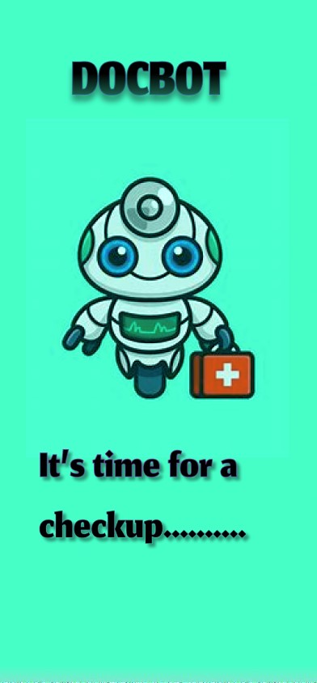
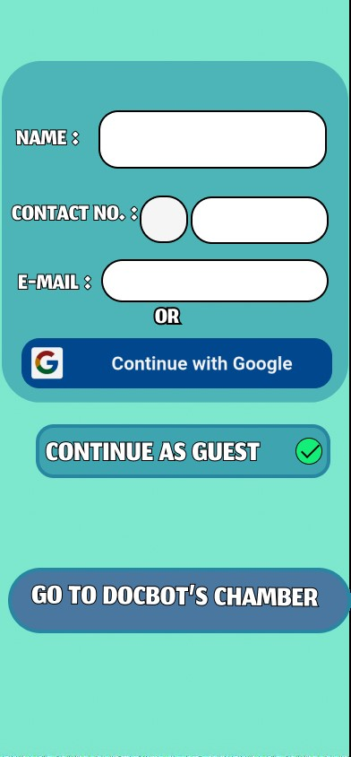
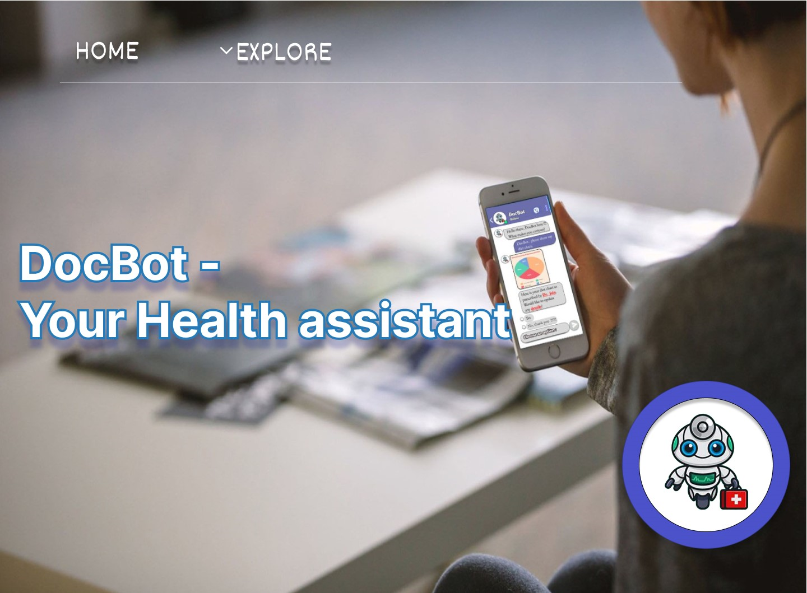
Home UI of the App:
This is a Demo of the Home Screen of the app. After clicking the below icon, the next window opens. After this brief animation on the ChatBot window, the Login screen opens, where the user is required to fill the details, as shown in the UI.
→
→

Slide 5
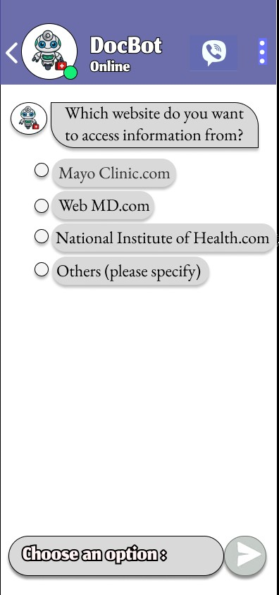
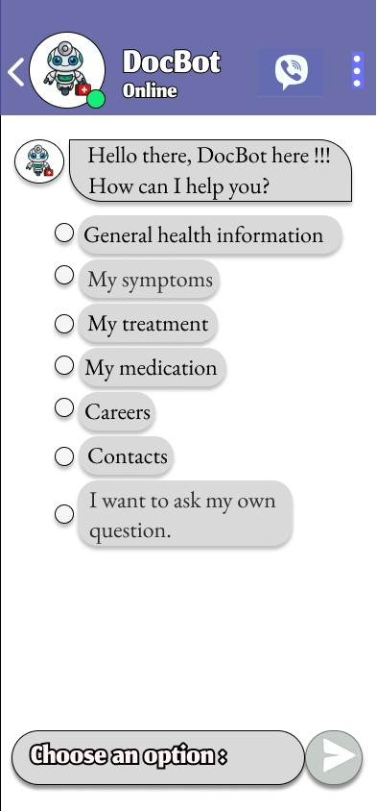
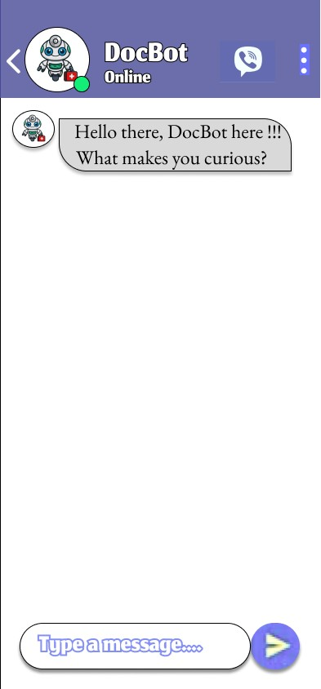
Initial Interface :
This is interface after the user is logged in. At first the user is asked to choose the source from where the user wants to access information. Then the user is given few options to ask queries, or the user can type his/her own custom questions.
→
→

Slide 6
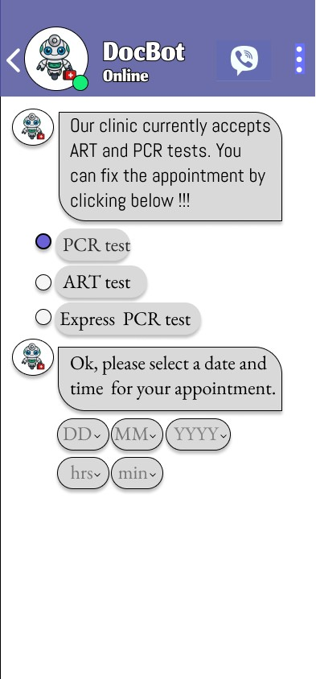
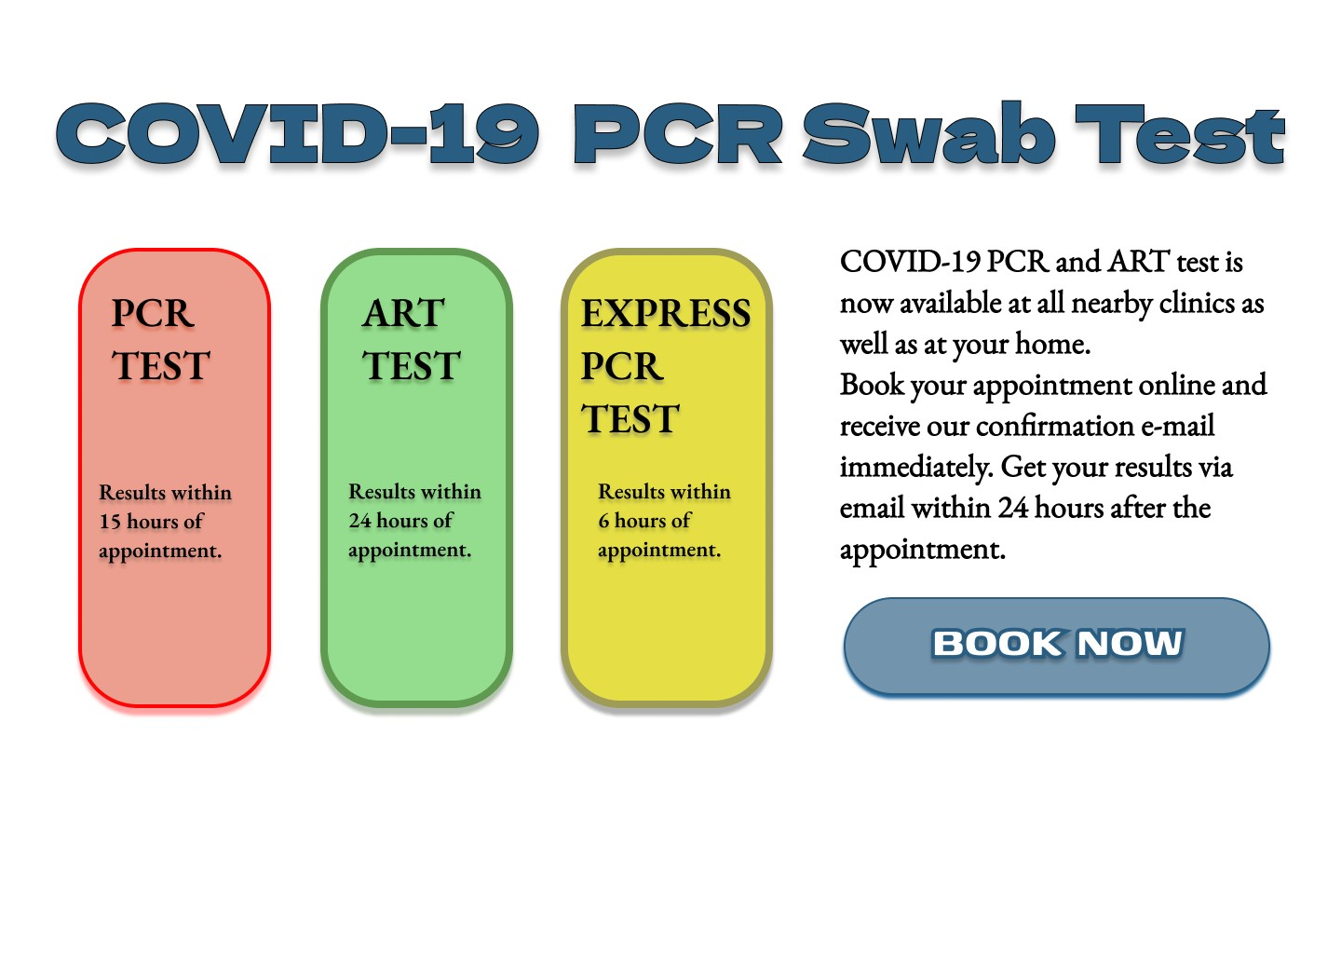
Covid Test Booking:
This is a Demo of the Covid Test Booking of the app. The user is given links to choose from the available tests, also the feature to set date and time of the selected test. Upon clicking the link ,the page for booking appointment opens next.
→

Slide 7


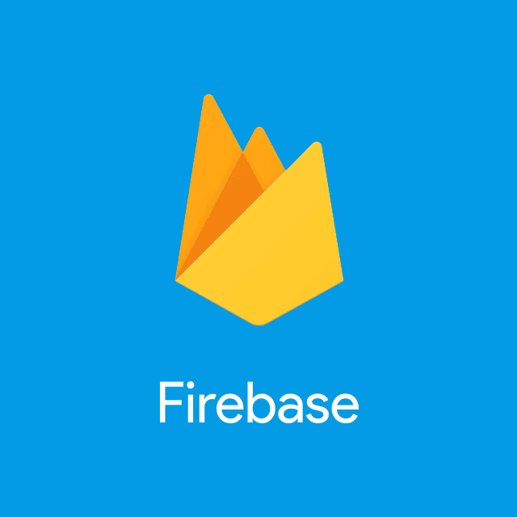



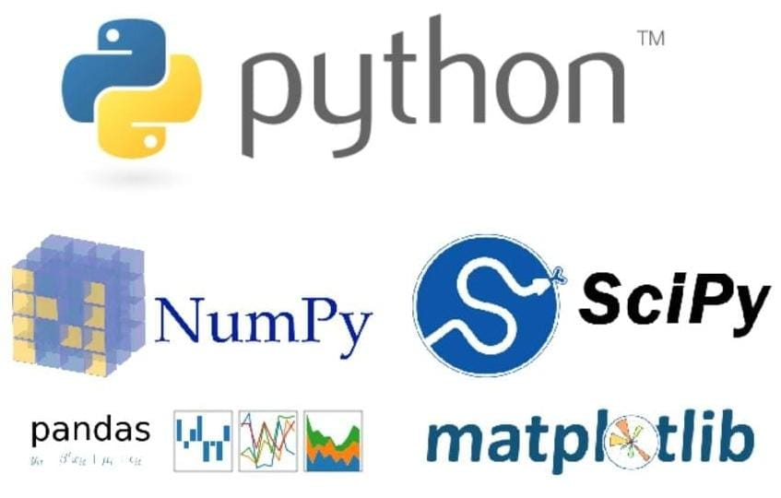
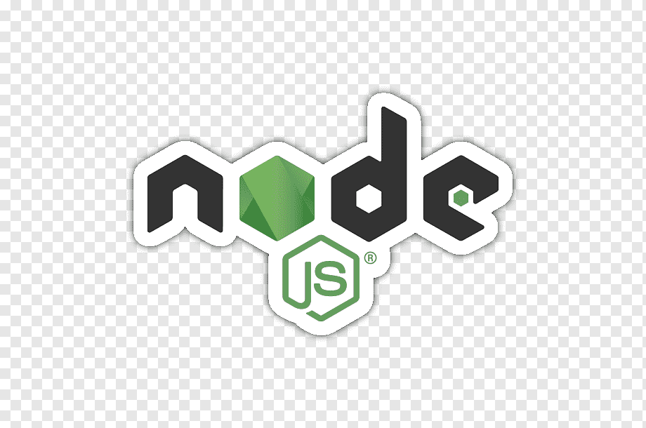


Tech Stack:
DESIGN:
FRONTEND:
CLOUD SERVICES:
BACKEND:
DATABASE:
ML/AI:

Slide 8
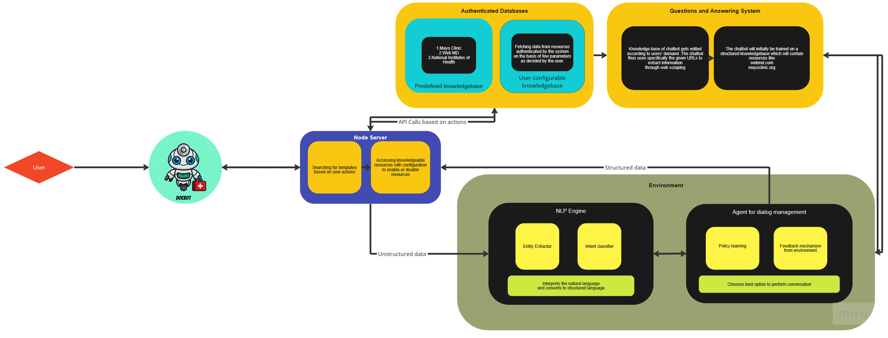
Architecture (made with MIRO)
Link: Click this text here to get a higher resolution of the architecture.

Slide 9
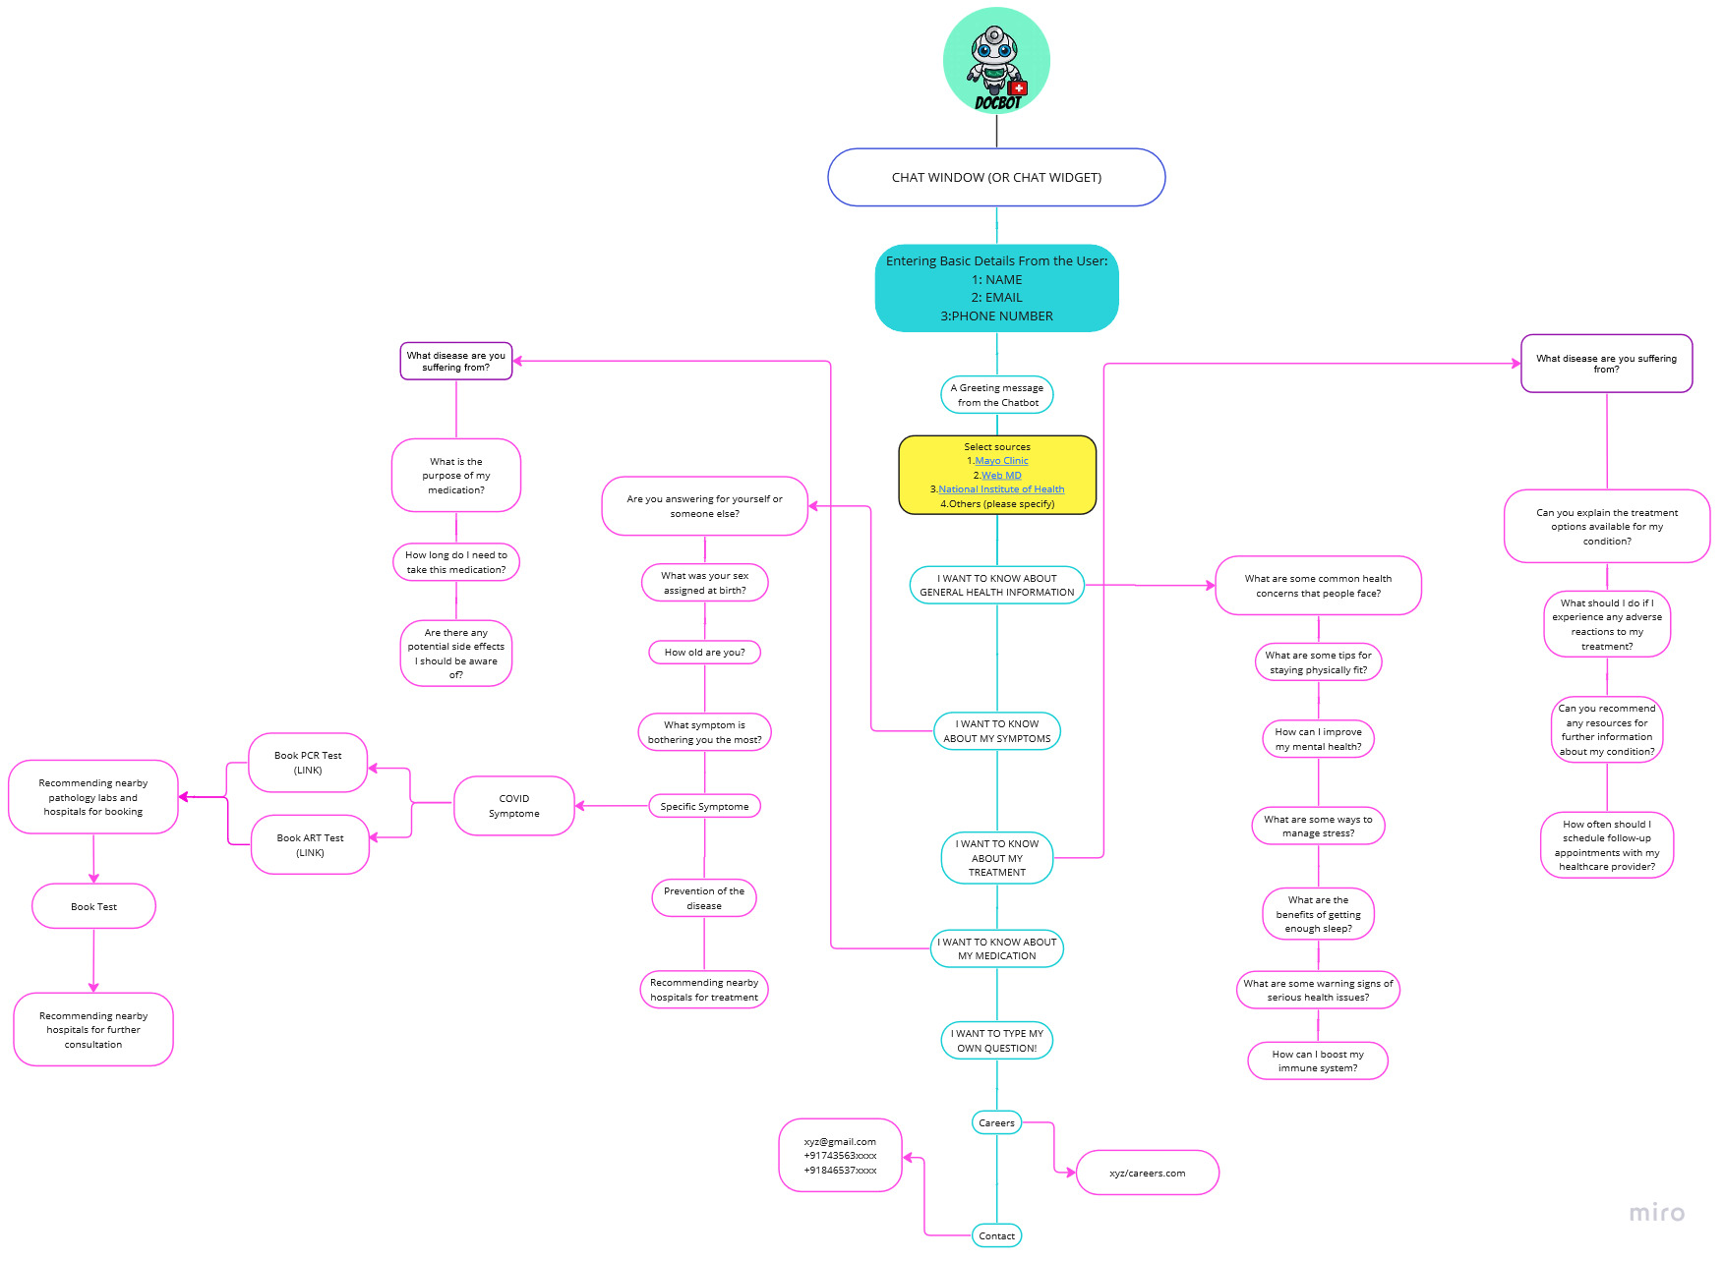
Data Flow Diagram (made with MIRO)
Link: Click this text here to get a higher resolution of the data flow.

Slide 10

The ML Model:
Document Indexing: Index and organize the predefined set of documents in a structured format, such as a database or a document management system. This allows for efficient retrieval and search capabilities.
Document Parsing: Develop a document parsing system that extracts relevant information from the documents. This could involve techniques such as Natural Language Processing (NLP) to identify key entities, topics, and relationships within the documents.
Query Processing: Implement a query processing mechanism that can understand user queries and map them to relevant documents or sections within the knowledge base.
Contextual Understanding: Implement context-aware algorithms that consider the conversation history and user context to provide more accurate and relevant document recommendations. This can help the chatbot understand the user's intent and refine the search results accordingly.
Natural Language Understanding: Use NLP techniques to interpret and understand the user's queries in a way that matches the document content. This can involve entity recognition, or topic modelling to improve the matching accuracy.
Continuous Updating: Regularly update and refresh the predefined set of documents to ensure that the chatbot has access to the latest and most relevant information. This can involve automated processes or manual curation depending on the frequency and nature of document updates.
Prioritize Improvement Areas: Prioritize the identified improvement areas based on the frequency and severity of user feedback. Focus on addressing critical issues first and then move on to less critical ones.
• Identify Patterns • Update Knowledge Base • Retrain the Chatbot

Slide 11
So, how is your solution different?
USP of our approach lies in the ability to offer configurable options for users, enabling them to enable or disable specific sources based on user's preference.
Additionally, our solution includes a corona self-checker module for risk identification and a Corona test booking module.
Furthermore, we added unique features to our solution, by introducing medication reminder, creating personal health tracker( diet chart) , sharing location of the doctor based on the disease.
The UI/UX of the app has been designed from scratch, is unique and one of it's kind.
We have given a strong emphasis on accuracy, UX, technical implementation, scalability, and continuous improvement based on user feedback. Also, we are implementing the features in simpler and easy to understand way for the user.

Slide 12
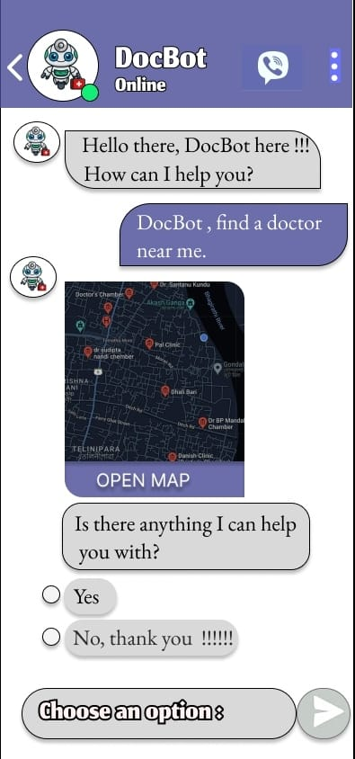
Structure of the app for additional features:
1. Locating Nearby Doctors
The chatbot can tell user more about a disease or finds a special location for the user, like a doctor or a pharmacy. It can search for nearby available doctors by using Google Maps API.
It efficiently identifies and presents nearby doctors, ensuring convenient access to healthcare professionals within the user's vicinity.

Slide 13
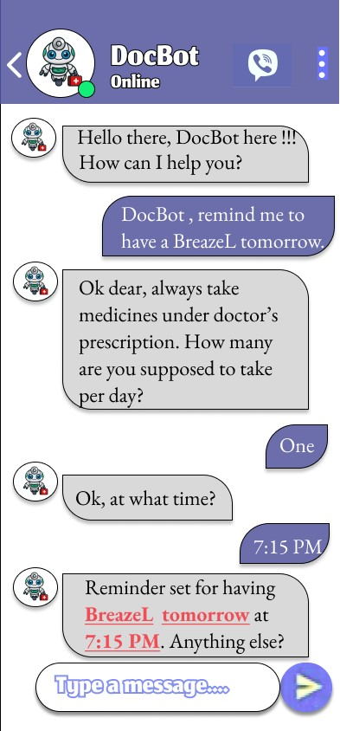
2. Medication Reminder
A lot of patients don’t take medication as prescribed and therefore risk their health. The chatbot reminds users to take their medication on specific date and time, based on disease and doses prescribed by the doctor , motivates them to be adherent with their regimens, and is also able to present medicine specific information.
Similarly, it can also remind the user about any booked test, that can be customized by the user.

Slide 14
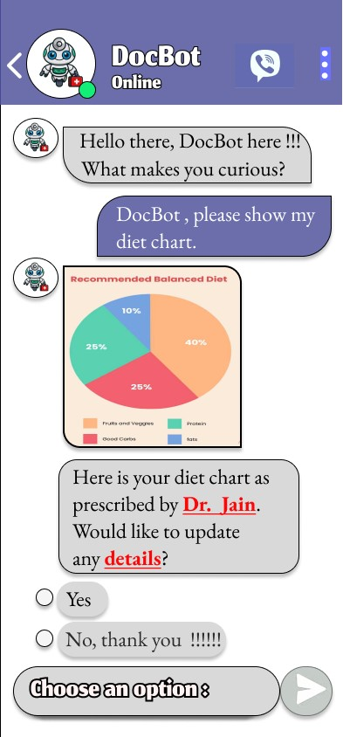
3. Personal Health Tracker
This feature will keep track of health of the user and helps user to reach their goals. For example, user can track their diet, where the Bot will recommend personal diet plans based on Age and Gender.
Similarly, it can also keep track of user's body weight, mood or any other similar things with the Bot.

Slide 15
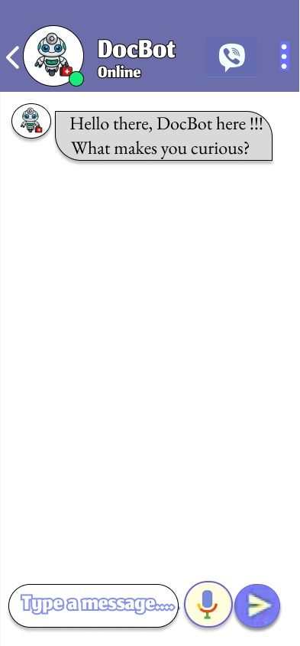

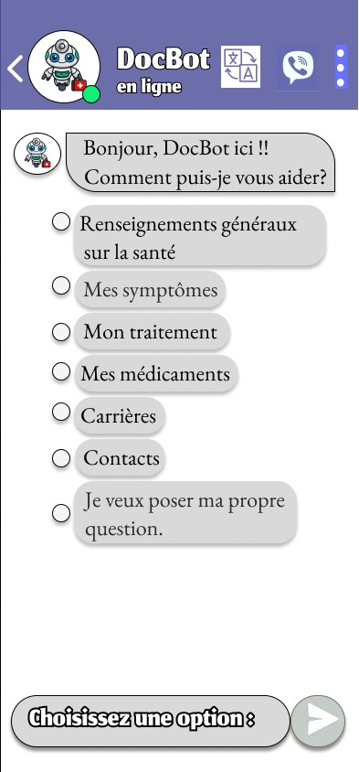

Future possible enhancements
We can add a Multilingual Button on our ChatBot, which converts entire content of the page to the language selected by the user.
We can integrate google assistant on our Chatbot, which lets user communicate with the Chatbot with voice.

Slide 16
Risks/ Challenges / Dependencies
To ensure that the Chatbot platform can handle a large number of simultaneous users and provide quick and responsive interactions may require careful design and optimization.
Integrating with reputable knowledgebase sources and authenticated databases may involve technical complexities, such as API compatibility, data retrieval, and data processing. Ensuring seamless connection and reliable access to these sources may require thorough testing and troubleshooting.
Scaling the infrastructure and managing increased traffic efficiently could pose challenges.
WebMD, Mayo Clinic etc. are US based, hence certain medicines and treatments stated may not be available in India.
Treatment suggestions specific to futile diseases such as Cancer may be ambiguous due to continuous research and development in that field.
Several diseases may have common symptoms that can leave the user in confusion.
Booking doctor consultation may require partnership with hospitals which require additional investment.

Slide 17
Acceptance Criteria Coverage
How many aspects of the problem statement have been covered?
• An end-to-end Chatbot platform that seamlessly integrates with reputed knowledgebase sources, including websites like: i. Mayo Clinic [https://mayoclinic.org/] ii. Web MD [https://www.webmd.com/]
• Configurable options to enable and disable resources
• Corona self-checker and booking module
• Ability of the model to continuously learn from past experiences.
• Future enhancements and additional features.
• Overcoming information overload with precise, authentic and trustworthy information
• Corona self-checker and test booking
• Judging criteria coverage

Slide 18
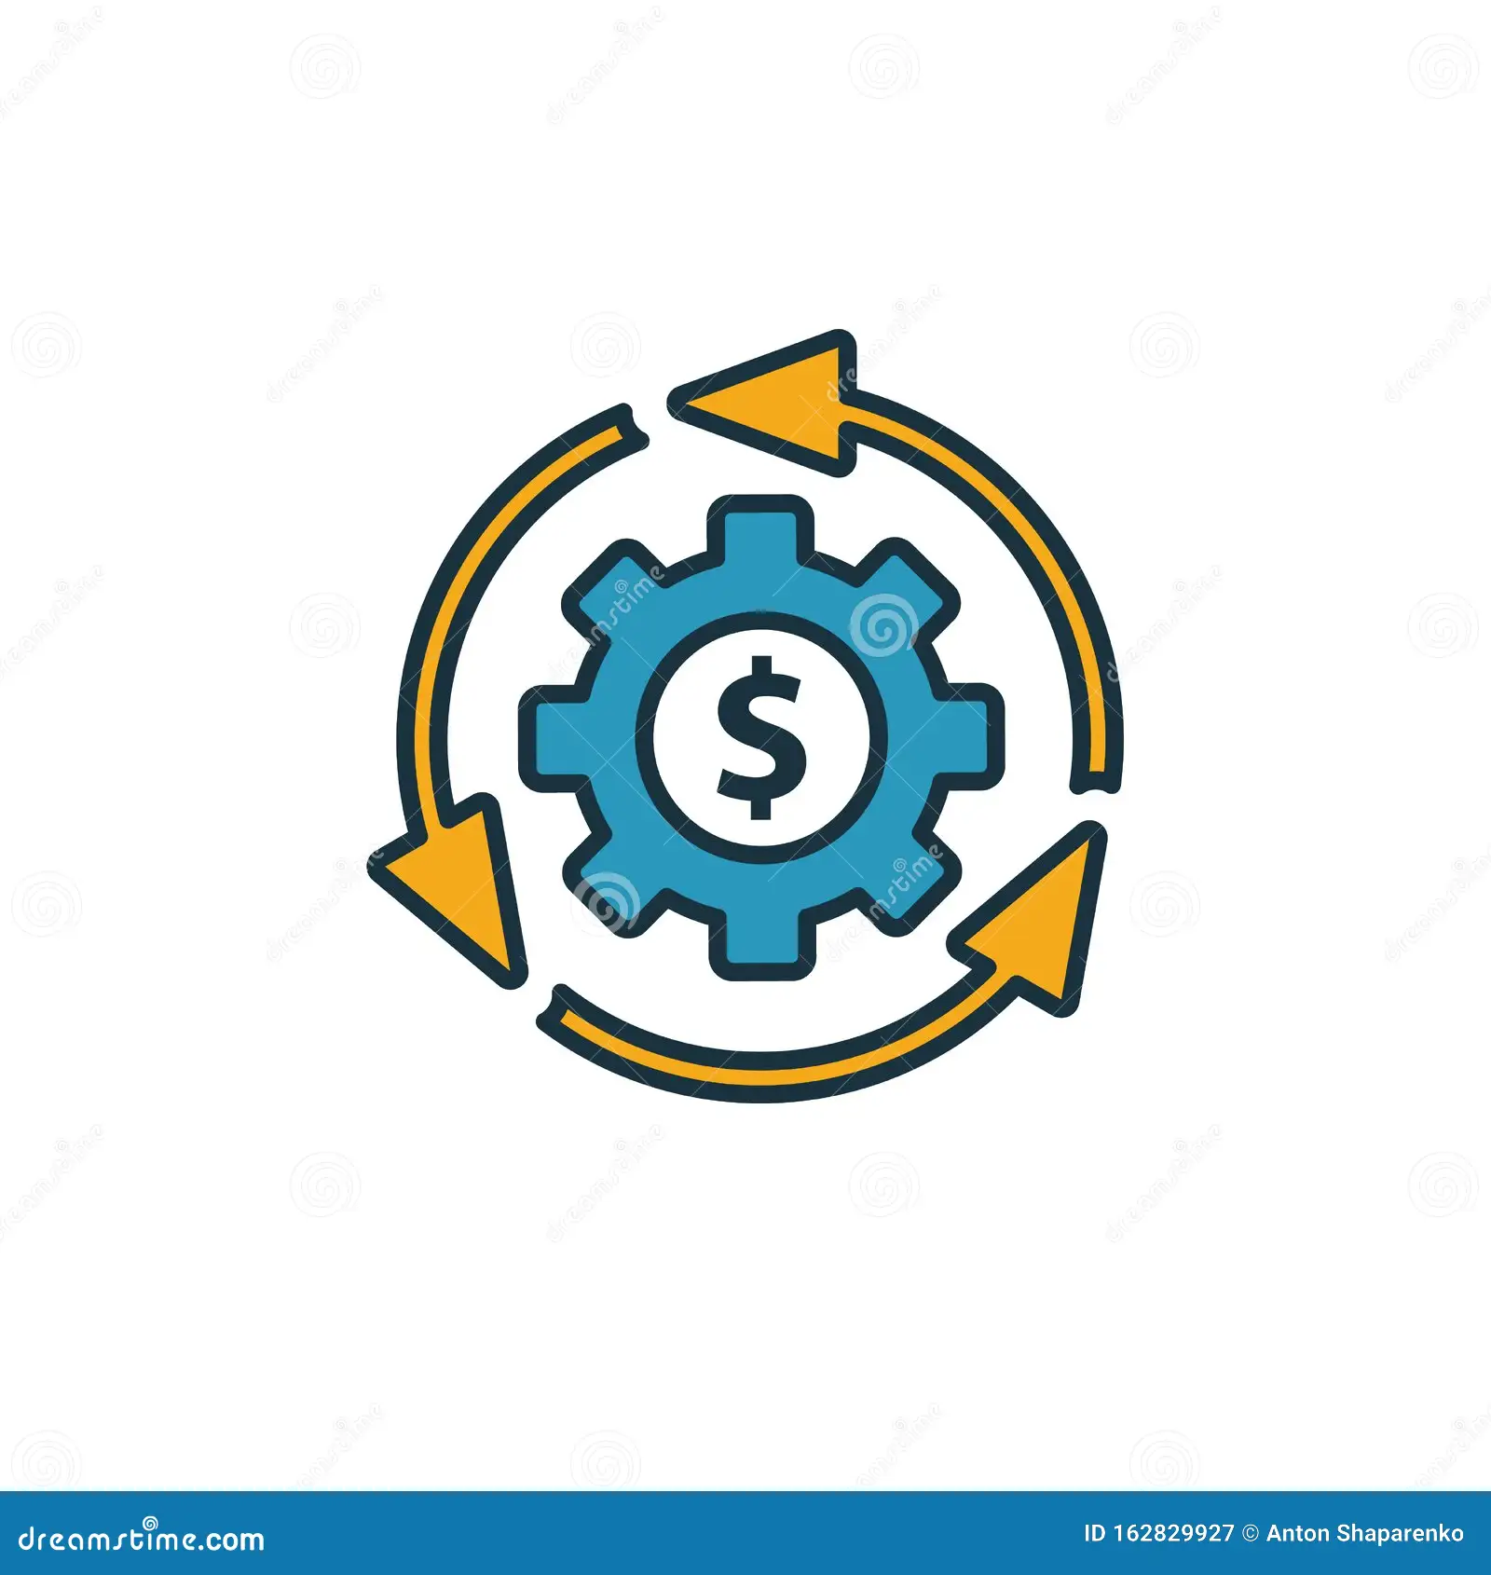
Business Model (B2C) / Customer Segment
Free Version:
Ads
Only Medication Reminder
Paid Version:
No Ads
Personal Health Tracker, along with Locating Nearby Doctors.

Slide 19
Thank You!

